Slide 1
OBJECT-ORIENTED PROGRAMMING PROJECT
Personal Finance Management System
A comprehensive desktop application designed for streamlined financial tracking, budgeting, and asset management.
DEVELOPED BY
Sara Laithy & Aya Abdelmoniem

Slide 2
CORE CONCEPT
Addressing Personal Financial Control
Financial awareness begins with structured data capture. Our application bridges the gap between raw spending data and actionable insights through a clean desktop interface.
The Problem
The Solution
Core Benefit
Manual tracking leads to inconsistent records and hidden overspending.
An automated, modular desktop app with instant summary metrics.
Real-time calculation and seamless file persistence.
System Architecture & Design
Slide 02

Slide 3
TECHNICAL FOUNDATION
Modular OOP Design Pattern
The project is separated into clean, decoupled layers ensuring maintainability and robust error handling.
GUI LAYER
SERVICE LAYER
DATA LAYER
GUI/app.py
services/finance_manager.py
Data/file_manager.py
Tkinter interface, tab navigation, and event bindings.
Business logic, summaries, and calculations.
JSON data persistence and secure file input/output.
Architecture & Stack
Slide 03

Slide 4
TEAM RESPONSIBILITIES
Student A: Core Backend & Data Logic
Responsible for building the robust backend engine, data models, and persistence controllers.
01
Object Models Design
Created Account, Transaction, Category, and Budget class structures.
02
File Persistence Manager
Implemented FileManager to read and write transaction lists safely to JSON.
03
Unit Testing Suite
Authored automated tests in Test/test_services.py to verify calculations.
Task Distribution
Slide 04

Slide 5
TEAM RESPONSIBILITIES
Student B: GUI & System Integration
Designed the desktop user experience, multi-tab layout, and backend service integration.
01
Multi-Tab Notebook Architecture
Created Dashboard, Transactions, Budgets, and Categories tabs.
02
Interactive Forms & Treeview Tables
Built entry fields, radio buttons, comboboxes, and live data grids.
03
Service Linkage & Refresh Loops
Connected user triggers directly to FinanceManager for real-time calculations.
Task Distribution
Slide 05

Slide 6
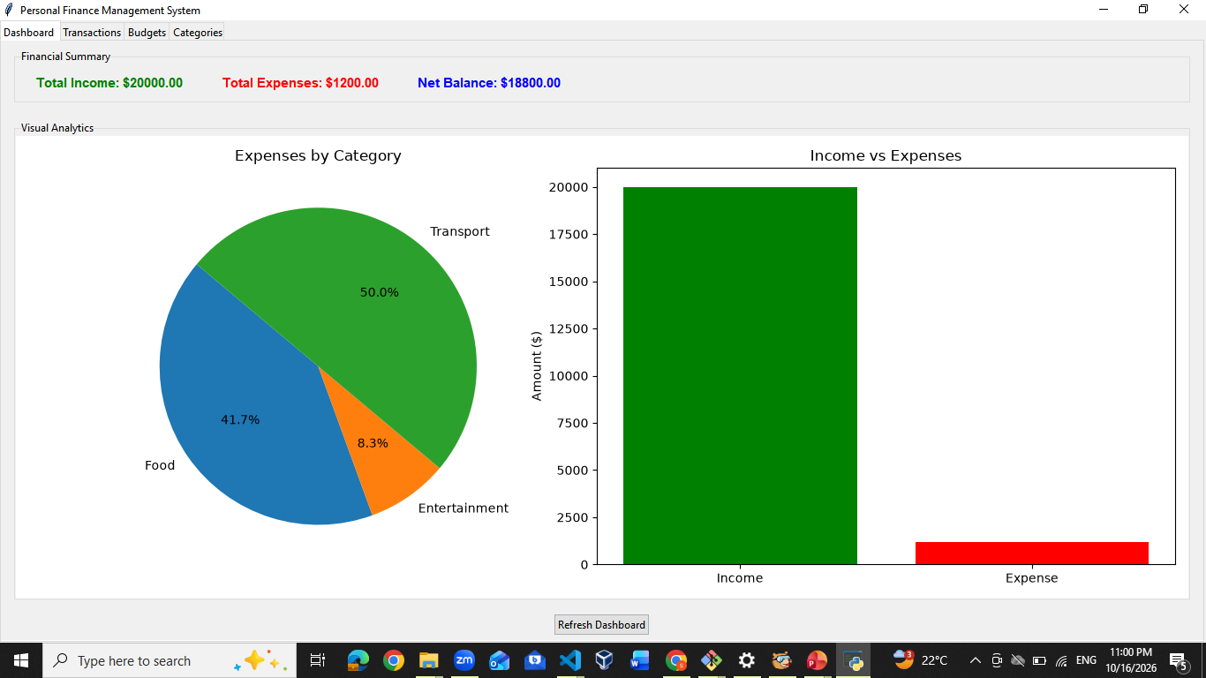

APPLICATION PREVIEW
Dashboard & Summary View
Real-time financial health indicators showcasing total income, expenses, and net balance.
[ 🖼️ INSERT DASHBOARD GUI SCREENSHOT HERE ]
Recommended size: Full application width showing summary metric cards
GUI Preview
Slide 06

Slide 7
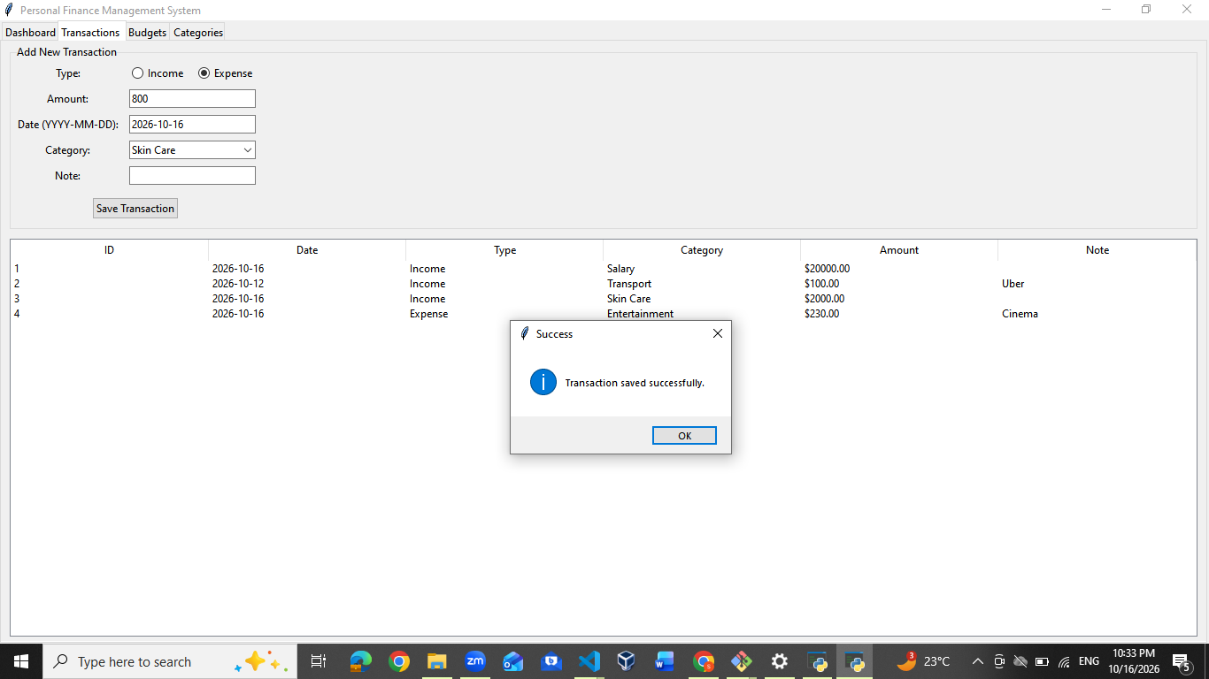
APPLICATION PREVIEW
Transactions & Entry Management
Form inputs for adding records alongside the structured Treeview records table.
[ 🖼️ INSERT TRANSACTIONS TAB GUI SCREENSHOT HERE ]
Recommended size: Showing top form inputs and data grid table below
GUI Preview
Slide 07

Slide 8
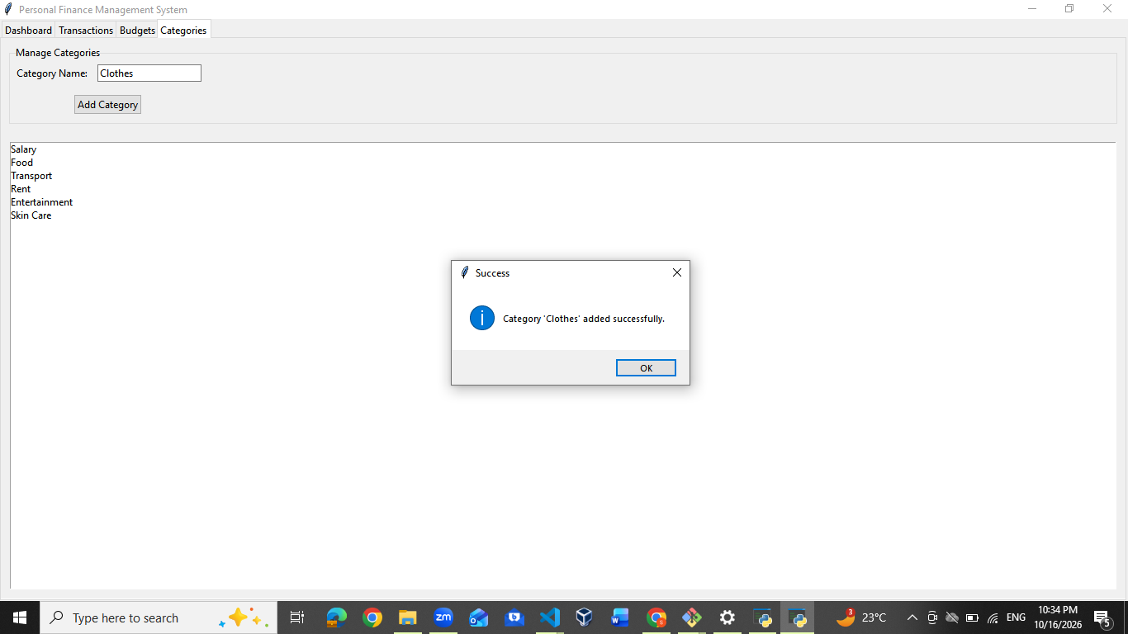
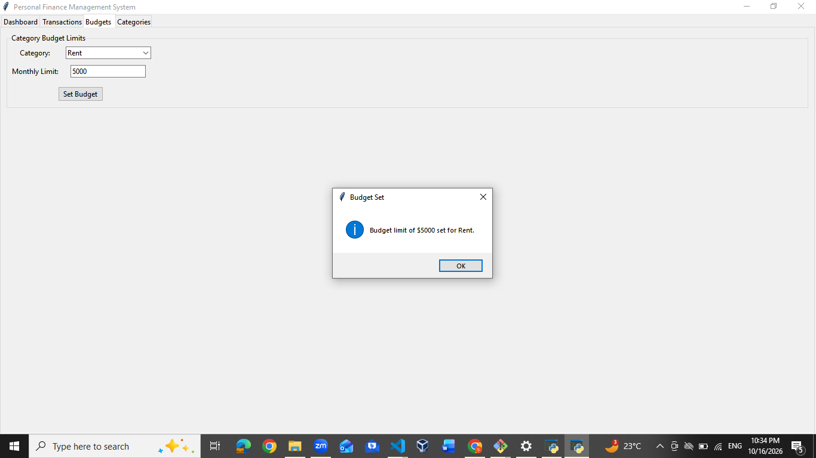
APPLICATION PREVIEW
Budgets & Categories Tabs
Dedicated control views for establishing monthly category spending limits and adding custom tags.
[ 🖼️ INSERT BUDGETS & CATEGORIES TABS GUI SCREENSHOT HERE ]
Recommended size: Side-by-side or stacked view of budget limits and category lists
GUI Preview
Slide 08

Slide 9
PROJECT SUMMARY
Conclusion & Future Roadmap
Successfully delivered a reliable, modular desktop application fulfilling all core OOP requirements.
Project Achievements
Future Enhancements
• Clean separation of concerns.
• Export reports to PDF/CSV.
• Seamless file data persistence.
• Graphical chart analytics.
• Intuitive multi-tab user interface.
• SQLite database migration.
Conclusion
Slide 09

Slide 10

Thank You!
Open for questions and discussion regarding the Personal Finance Management System.
Sara Laithy
Aya Abdelmoniem

